Slide 1

Graded Assignment in DTE-2502
Training self-driving Duck in Duckie Town simulator
using Deep Q Network algorithm

Slide 2
What is DQN?
A reinforcement learning algorithm modeled from a human learning from experiences and optimizes his actions to get highest utility (reward here) given situations.
It uses 2 neural networks as part of the algorithm, functions as intelligence of the person, and Replay Buffer which functions as memory of the person.

Slide 3
Components of DQN
Two neural networks: evaluation and target network, as intelligence of the person.
Replay Buffer like memory of the person about experiences.
Replay Buffer saves transitions.
Transitions (action, state, next_state, reward, done).

Slide 4
Transitions
DQN is modeling a human learning from experiences.
Action: action that’s taken
State: The state you’re in. E.g. position, orbit and speed of the car.
Next_state: the state that action puts you into.
Reward: consequences of the action (like utility of the action taken).
Done flag: termination flag, wheter to continue or start a new game.
Every given state has multiple action opportunities, and each action puts you into new state and gives you some reward. The goal is to maximize reward in the long term.

Slide 5
How DQN Works? (In Duckie Town)
From a given state, we choose an action (first random, then more and more based on neural net, evalutaion network).
We apply the action in environment and we get result (next_state, reward, done flag) of our action.
We save the transition (state, action, next_state, reward, done flag) into ReplayBuffer

Slide 6
How DQN Works? (In Duckie Town)
We pick some random transitions from the ReplayBuffer, and to real reward of the first action we add predicted actions and Q-values using target network.
Q values are calculated long term rewards using Bellman equation.
We predict actions and Q-values using evaluation network.

Slide 7
How DQN Works? (In Duckie Town)
We optimize the evalution network based on the mean squared difference between the two Q values above (Q values from target net and evaluation net) using gradient descents.
After repeateing this process some time we update target network parameters so it equals evaluation network with soft update.
Soft update: target_params = tau * target_params + (1 – tau) * q_params, where tau is a hyperparameter in [0, 1)

Slide 8
How DQN works?
Why we use two neural networks (target and evaluation network)?
Actions and states depend on each other.
Conceptually it's like saying, "I have an idea of how to play this well, I'm going to try it out for a bit until I find something better" as opposed to saying "I'm going to retrain myself how to play this entire game after every move“ (https://stackoverflow.com/questions/54237327/why-is-a-target-network-required)

Slide 9
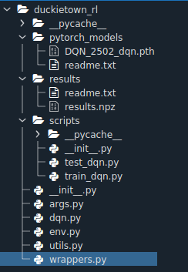
Structure of the code
Duckietown simulator in simulator folder
DQN implemented in Duckietown-rl:
utils.py: ReplayBuffer class
wrappers.py: preprocessing data, resize input images to 60x80, normalizing, discretizing actions and other wrappers etc.
env.py: instantiating and returning environment class with setup wrappers

Slide 10
Structure of the code
args.py: hyper-parameters defined as arguments with defaults, like epsilon value, episodes, max timesteps etc.
dqn.py: where the CNN network and DQN methods implemented, «predict» and «train» implemented, where we train both neural networks.
dqn_train.py: training algorithm of DQN
dqn_test.py: testing algorithm of DQN where we drive the duck.

Slide 11
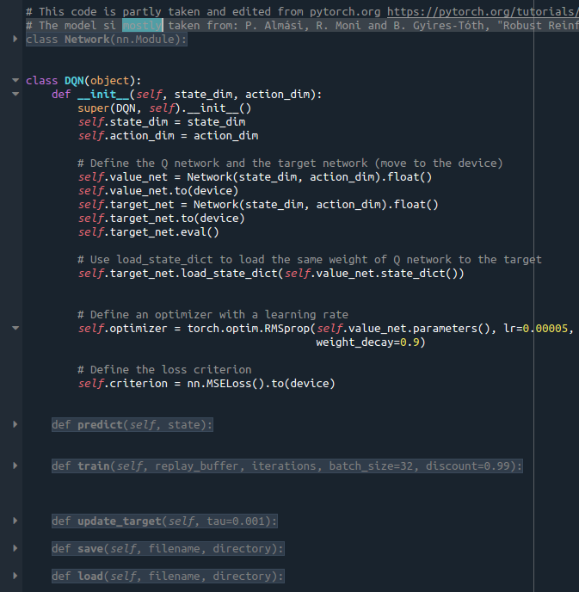
DQN class

Slide 12
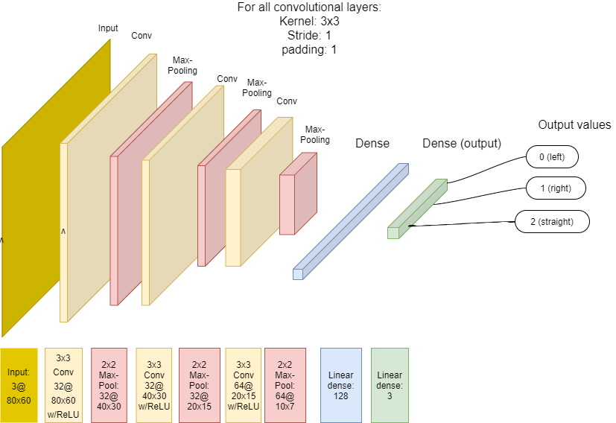
The CNN model
The model is mostly taken from:
P. Almási, R. Moni and B. Gyires-Tóth, "Robust Reinforcement Learning-based Autonomous Driving Agent for Simulation and Real World," 2020 International Joint Conference on Neural Networks (IJCNN), 2020, pp. 1-8, doi: 10.1109/IJCNN48605.2020.9207497.

Slide 13
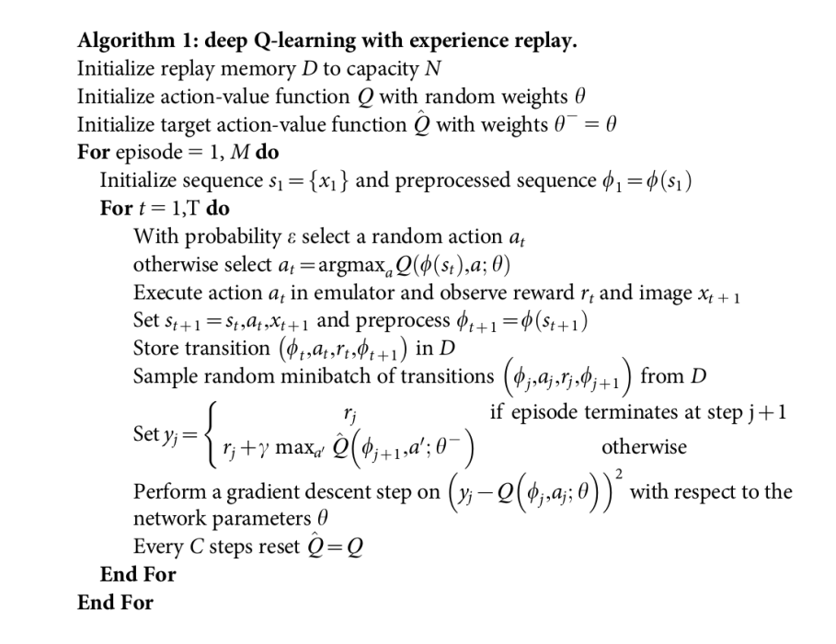
Source: Mnih, V., Kavukcuoglu, K., Silver, D. et al. Human-level control through deep reinforcement learning. Nature 518, 529–533
(Nature 2015). https://doi.org/10.1038/nature14236

Slide 14
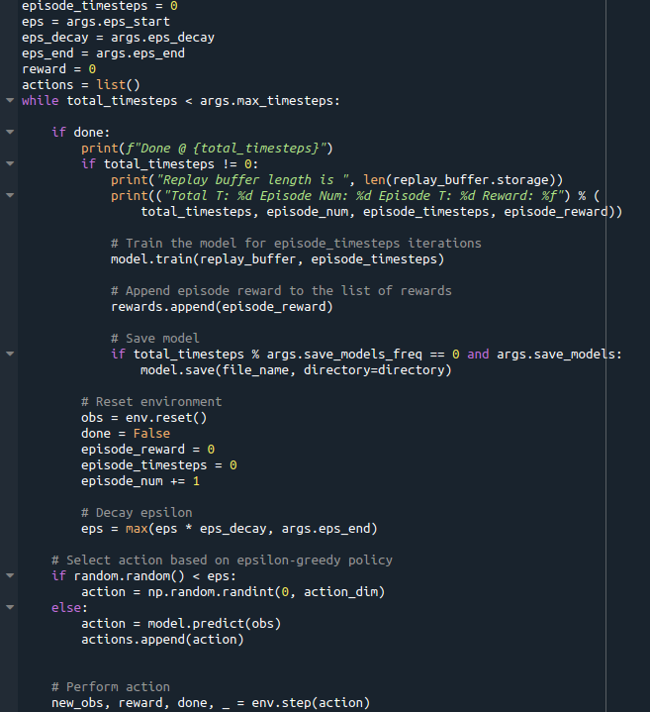

Slide 15
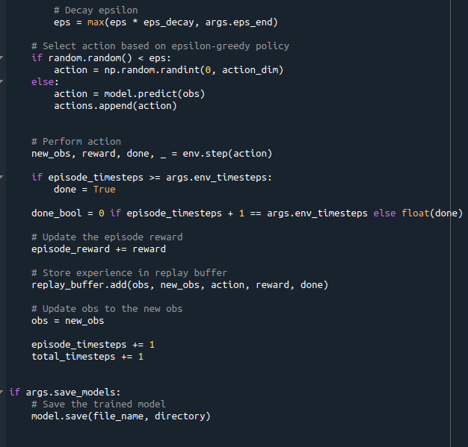

Slide 16
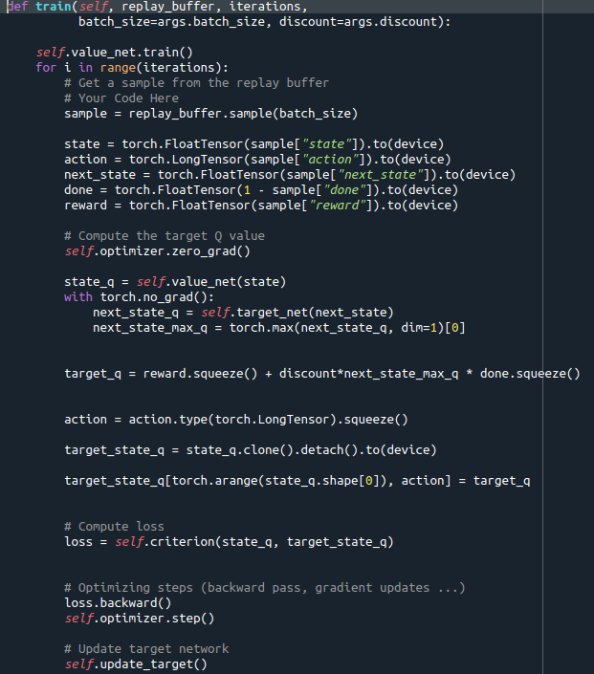
Note: In Polyak averaging (soft update) as we have, the update is on every timestep, not «every C step»

Slide 17
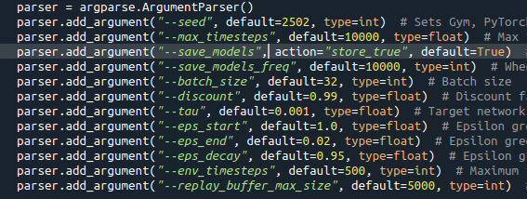
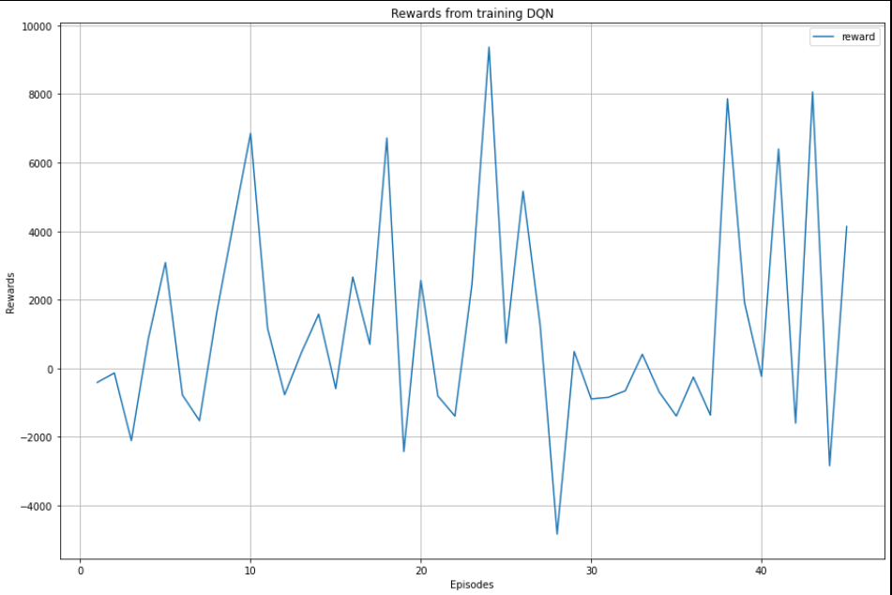
Training results (10,000 timesteps, 500 per episode)
Hyper-parameters from args.py
High oscillations. Probably because most choices are random, as we use greedy epsilon policy and that’s just first 40 episodes.
Or it’s possible the reward depends on the first state, e.g. if it starts from right lane it’s easier than if it starts from left lane.

Slide 18
Test results (3000 timeteps, 10 episodes)
Mean episode reward for each episode [18.193990420926497, 17.096928042131218, 17.875895629274385, 17.945090450506974, 16.224719470449763, 17.887463038299728, 17.20564739787699, 18.654975354245696, 13.11505056364926, 18.160128873544412]
Mean episode reward of all episodes: 17.235988924090492
Sum episode rewards for each episode: [54581.97126277953, 29475.10394463425, 53627.68688782308, 53835.271351520845, 20216.000460180403, 53662.38911489926, 27150.51159384989, 55964.92606273704, 9783.827720482332, 54480.386620633304]
Mean sum episode reward: 41277.80750195399
Driving slow and not straight, rotating to left and right often, but drives usually on right lane.
Managed to complete 3000 timesteps 6 of the 10 episodes
There’s room for improvement

Slide 19
Conclusions
The algorithm does learn
More fine-tuning
Testing with different CNN architectures
Even simple Atari games require hours of training with DQN, and Duckie Town is more complicated environment.
But because of hardware and time limitations that was not possible (just 10k timesteps take ca 2 hours, but we may need 100k+ timesteps).

Slide 20
Conclusion
Using Huber Loss could be better than MS
Better preprocessing like only showing white and yellow road lines to make processing input easier could improve performance (but only in this simple example, as we can’t ignore other cars and other traffic signs).

